Slide 1

Kaikorai Valley College
Opportunity and Success for All

Slide 2
Kaikorai Valley College
Health and Safety
Taking care
and enjoying the Farm

Slide 3
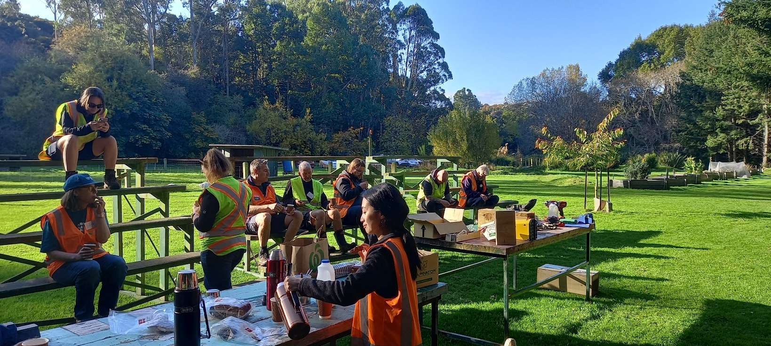
Kaikorai Valley College
Only enter the Farm if told to by your teacher
Always assemble together on the green seats near the barn

Slide 4
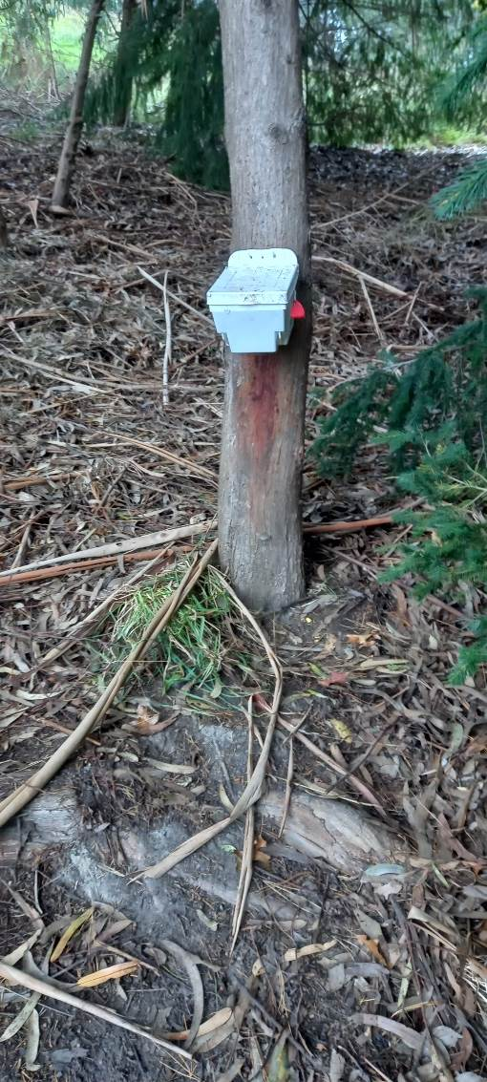
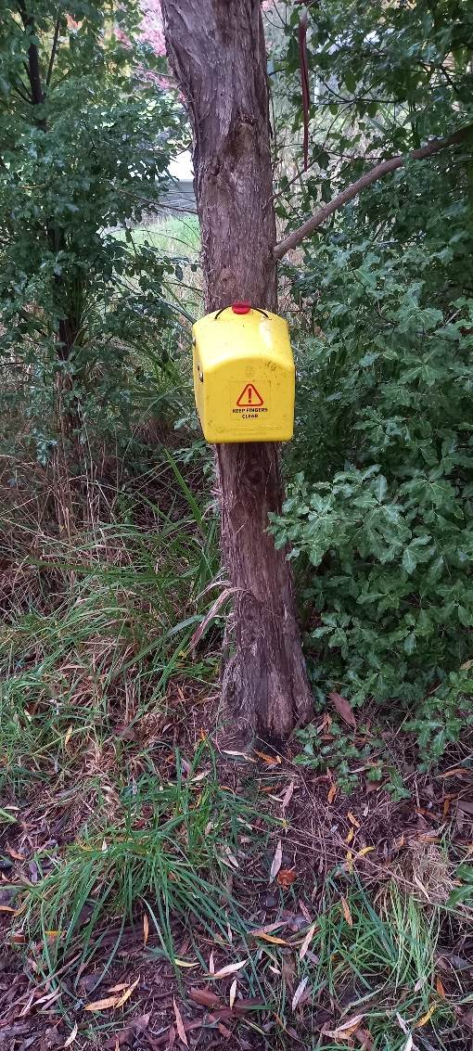
Kaikorai Valley College
Hazards – things to be aware of
Possum traps are dangerous
DO NOT TOUCH

Slide 5
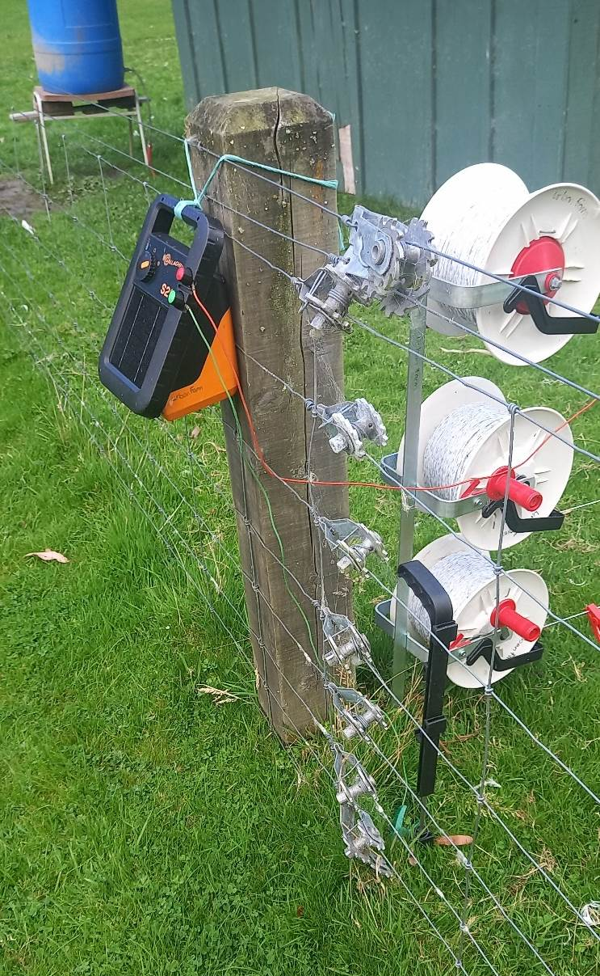
Kaikorai Valley College
Hazards – things to be aware of
Electric fences are dangerous
DO NOT TOUCH

Slide 6
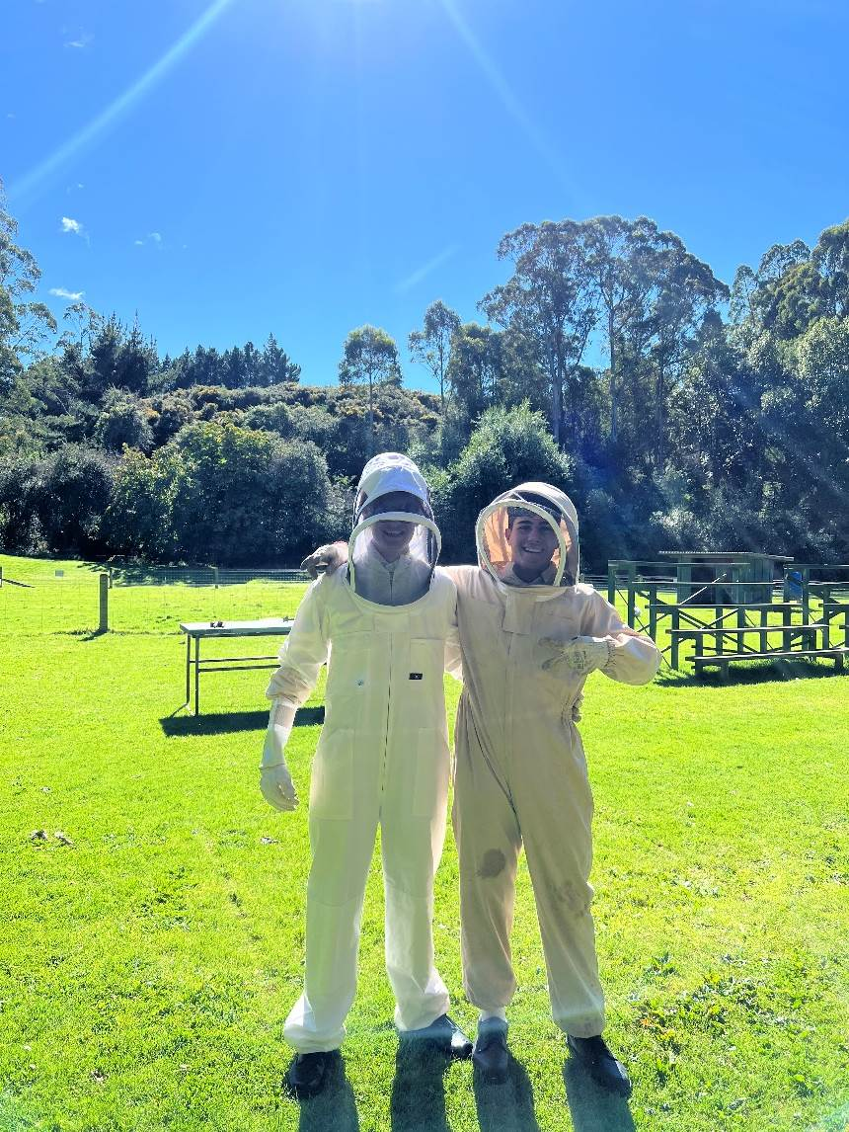
Kaikorai Valley College
Hazards – things to be aware of
Bees sting and some people are allergic to them
DO NOT TOUCH
DO WEAR A SUIT

Slide 7
Kaikorai Valley College
Hazards – things to be aware of
Animals stay behind the fence – you on the other side
All animals are treated with respect: be quiet, be gentle and keep hands away – animals can bite!

Slide 8
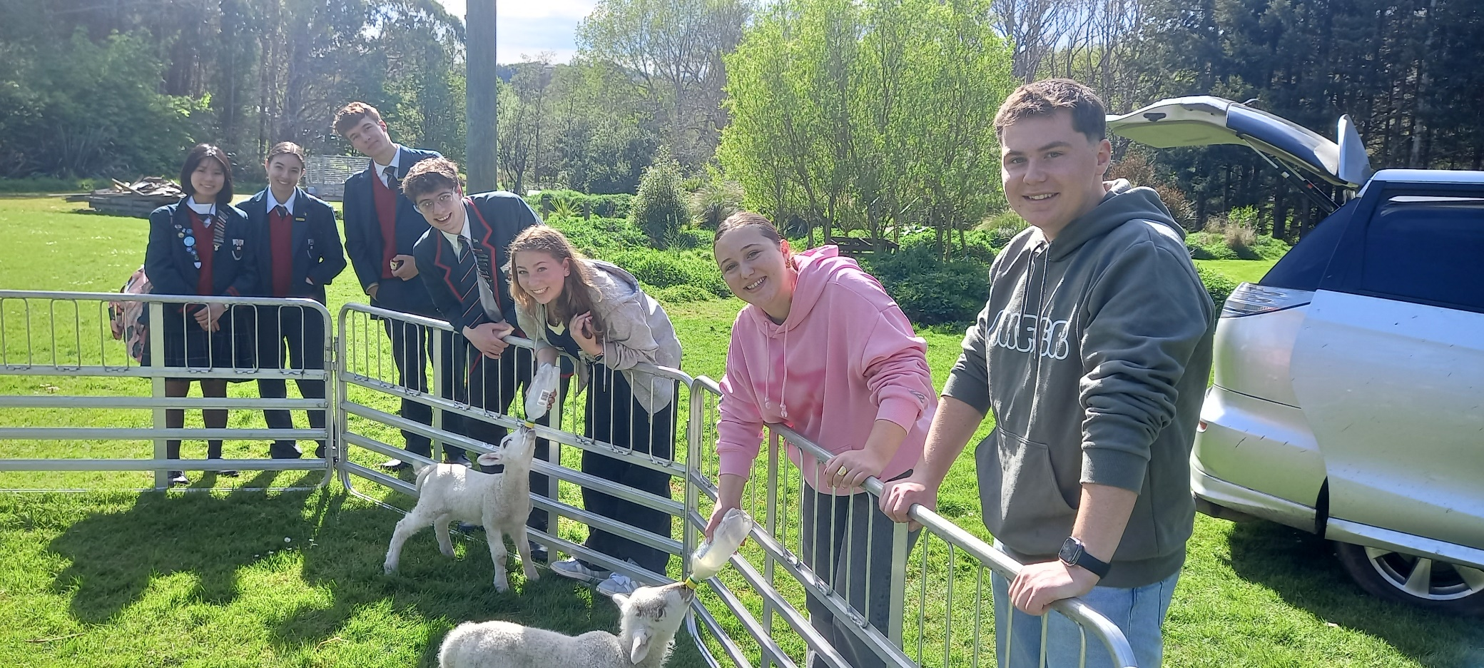
Kaikorai Valley College
International Students help out at the farm too

Slide 9
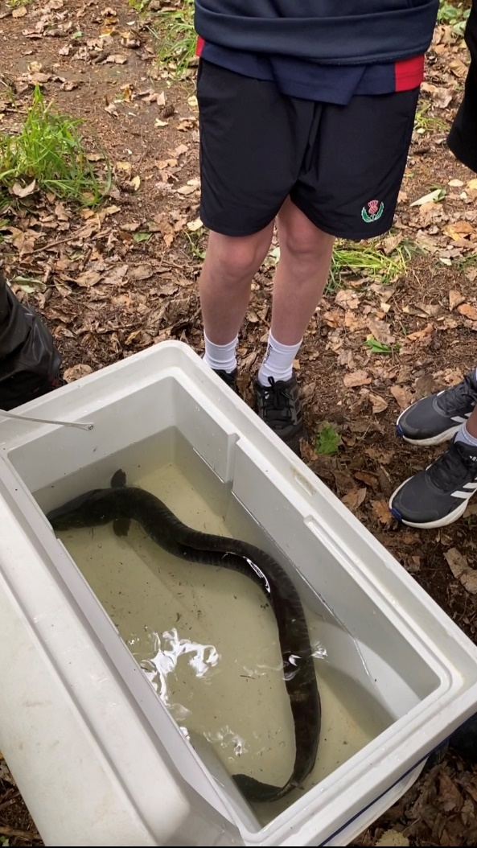
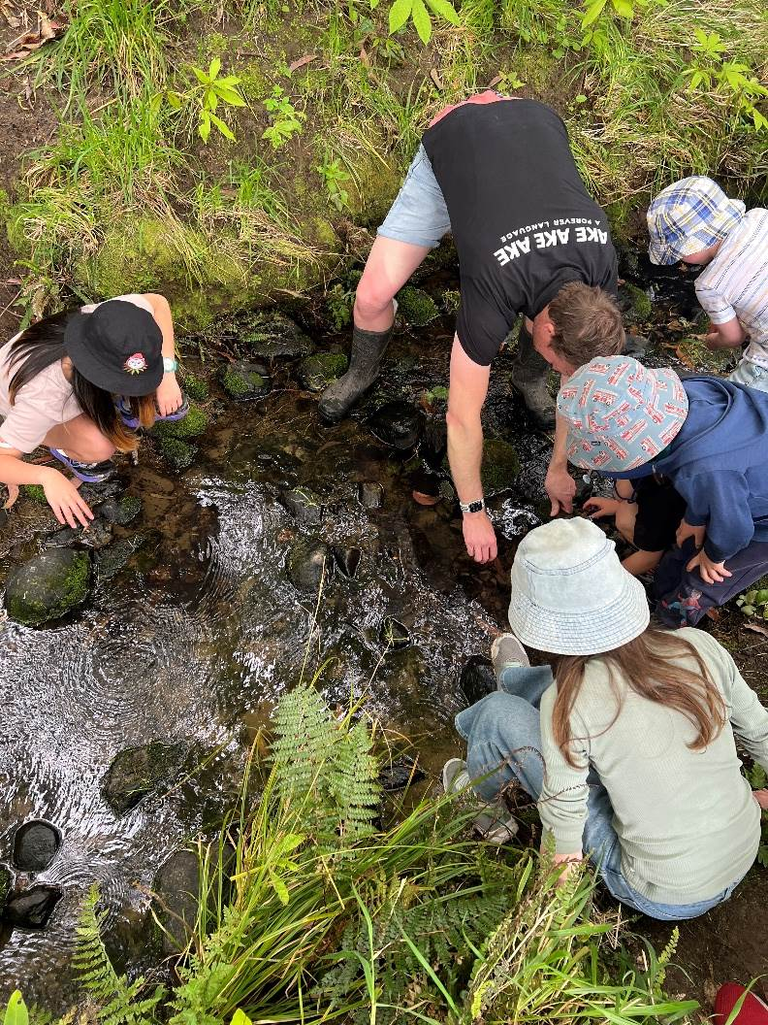
Kaikorai Valley College
There are animals in our streams too!
Take care of them and where they live.

Slide 10
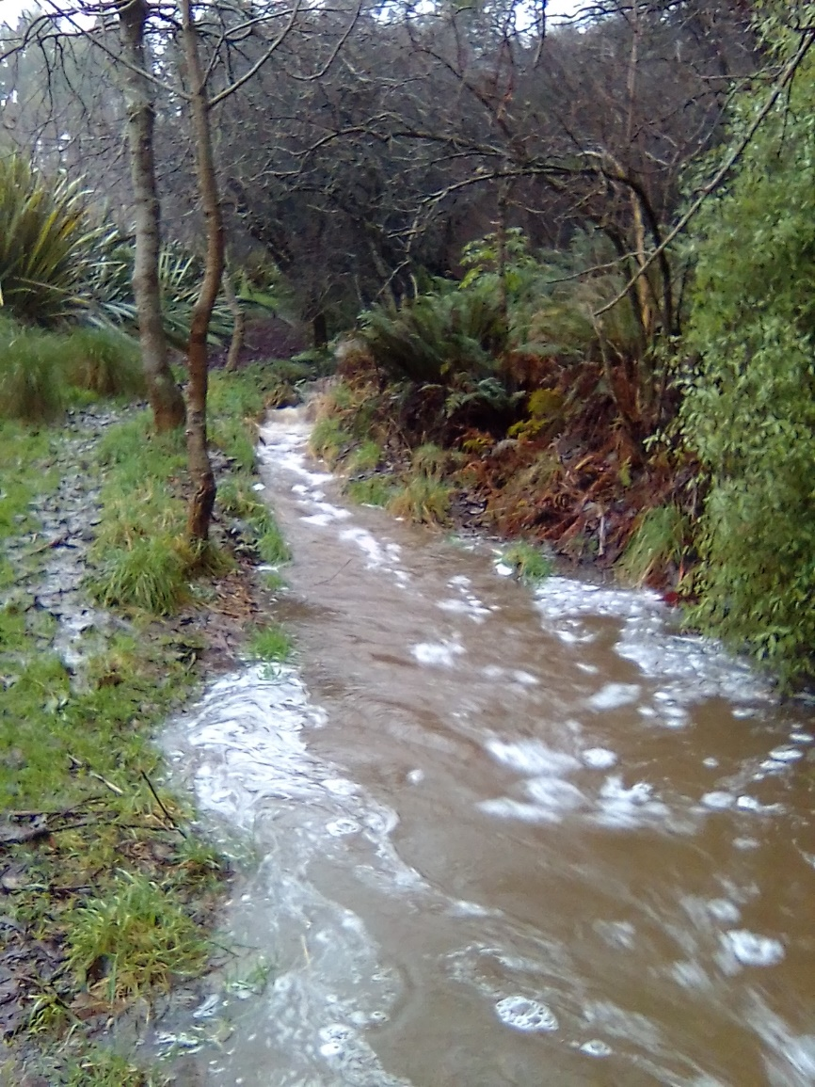
Kaikorai Valley College
NEVER go down to our streams alone and only with the teacher
NEVER go near a stream in flood

Slide 11
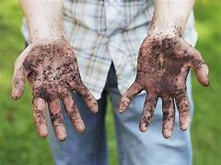
Kaikorai Valley College
Wash your hands before you leave the farm with soap & fresh tap water
Don’t put your fingers in your mouth, ears or up your nose!

Slide 12
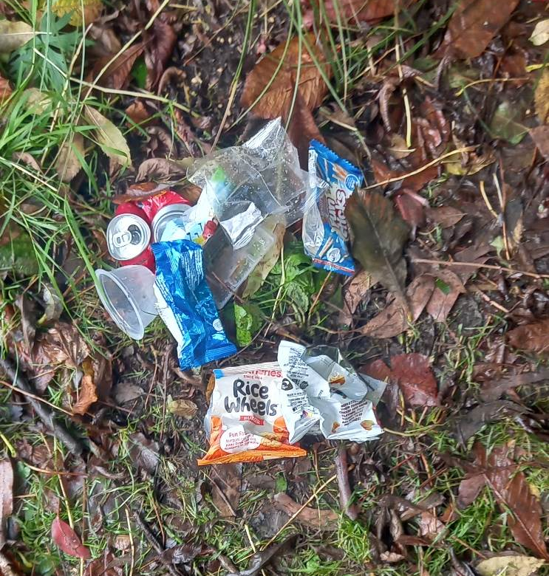
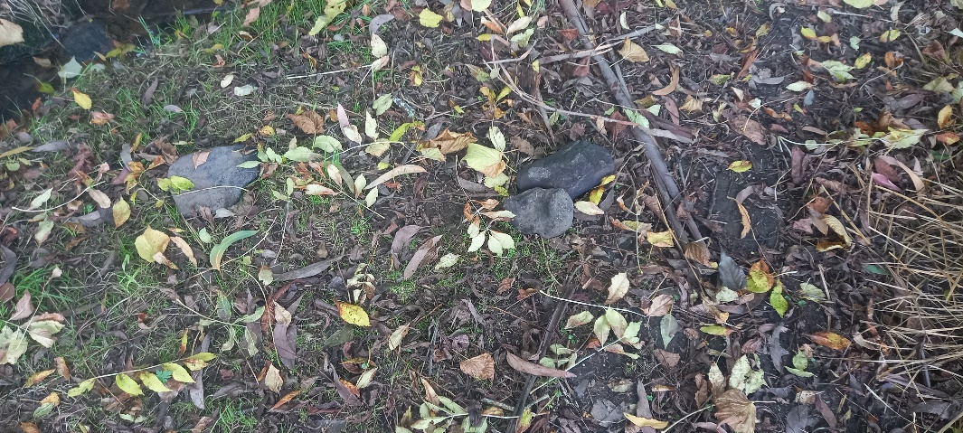
Kaikorai Valley College
Don’t bring your rubbish to our farm
Leave the environment as if you were never there

Slide 13
Kaikorai Valley College
Health and Safety
Take responsibility to keep yourself safe and your friends

Slide 14
